Slide 1
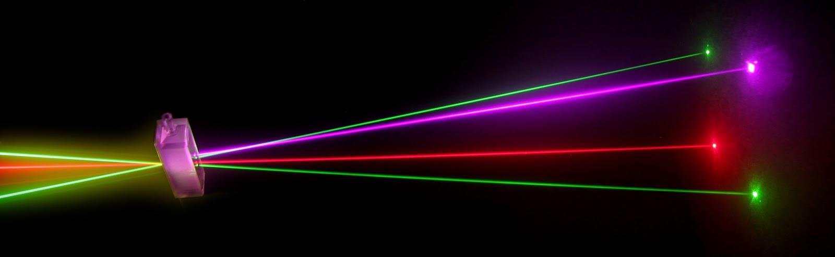
“Laser Technology and Applications” 16B1NPH533 Lecture 39
Liquid Laser
Semiconductor Laser

Slide 2
Liquid Lasers
Tunable Dye lasers
Active materials : A dye dissolved in a host medium of a liquid solvent
Situation similar to SSLs; where Cr³⁺, Nd³⁺ or Ti³⁺ ions used in a solid host
Advantages of liquid host is that concentration of the active ions can be easily varied.
Typical dye concentrations; 10⁻⁴ to 10⁻³ molar solution
10²⁴ to 10²⁵ dye molecules per cubic meter.
Over 200 dyes; Most important one being Rhodamine 6G
When used, produce tunable output over wavelength range 320 -1200 nm
Operates both in CW & Pulsed modes
Pulsed dye laser; pumped by a flash lamp or other laser ⇒400J in 10 μs pulses
CW dye laser; pumped by other CW laser (Ar– ion) ⇒Output Power ≈2W

Slide 3
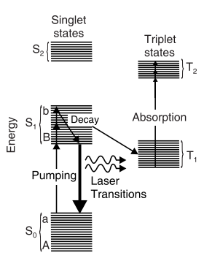
Gain of dye medium is very high ; a small volume of dye solution is sufficient to sustain lasing action.
Organic dye molecules have two sets of excited states
Singlet sates; S₀, S₁, S₂
Triplet states; T₁ & T₂
Transitions from singlet states to triplet states ⇒ forbidden
Optical pumping excites dye molecules from lowest vibronic level of ground state S₀ to one of upper vibronic level of excited state S₁
Undergo non-radiative transition to the
lower vibronic level of S₁ – acts as ULL
Schematic representation of the energy levels of an organic dye molecule.
Role of LLL played by one of the upper vibronic levels of S₀ – closely spaced levels ⇒ form a continuum

Slide 4
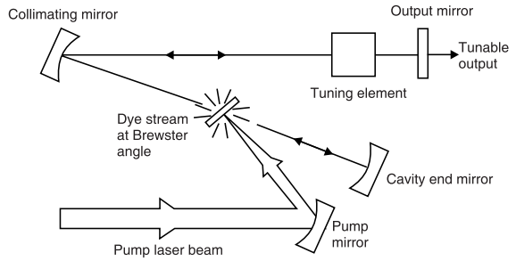
Laser transitions can be to various levels within a range defined by vibrationally excited sublevels on the ground state
⇒ Laser operates over a wide/broad range of wavelengths.
Schematic diagram of a laminar-flow dye laser

Slide 5
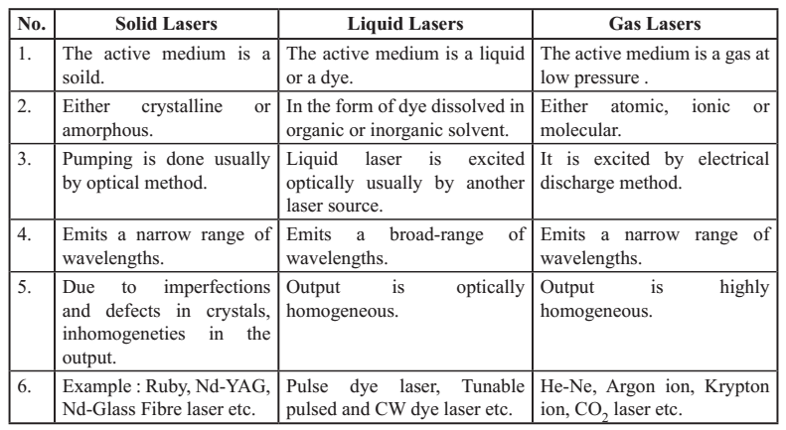
Comparison Between Solid, Liquid and Gas Lasers

Slide 6
Semiconductor Lasers ( Laser Diodes)
As compared to other laser systems, semiconductor lasers have some very attractive characteristics:
they are very small in size,
can be directly modulated by varying the drive current,
are very efficient converters of electrical energy to light,
can be designed to emit a broad range of wavelengths, etc

Slide 7
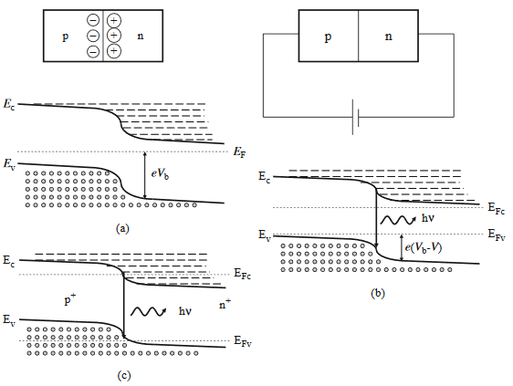
Gain In A Forward-biased P–n Junction
Consider a p–n junction formed between a p-doped and an n-doped semiconductor. The diffusion of these carriers across the junction leads to a built-in potential difference between the positively charged immobile ions in the n side and the negatively charge immobile ions in the p side of the junction. This built-in potential Vb lowers the potential energy of the electrons in the n side with respect to the potential energy of electrons in the p-side, which is represented by “bending of energy bands” near the p–n junction.
Unbiased p–n junction and
forward-biased p–n junction. When the p–n junction is forward biased, we can achieve optical amplification over a certain range of photon energies.
Forward-biased, heavily doped p–n junction
If a p–n junction formed by highly doped p- and n-type semiconductors, in which the Fermi levels are located inside the respective bands, application of a strong bias can lead to the gain condition which is the basis of operation of injection laser diode.

Slide 8
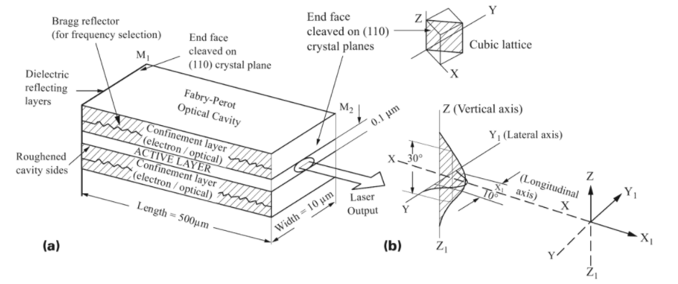
A laser diode consists basically of a forward biased p–n junction of a suitably doped direct band gap semiconductor material. Two ends of the substrate chip are cleaved to form mirror-like end faces, while the other two ends are saw cut so that the optical resonator is formed in the direction of the cleaved ends only. The large refractive index difference at the semiconductor–air interface provides a reflectance of about 30%, which is good enough to sustain laser oscillations in most semiconductor diodes. This is primarily due to the large gain coefficients that are available in semiconductors.

Slide 9
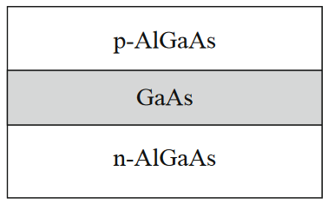
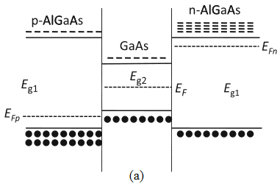
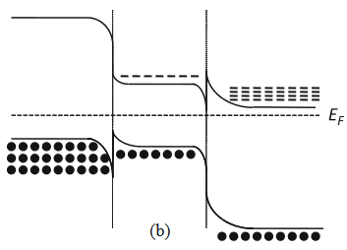
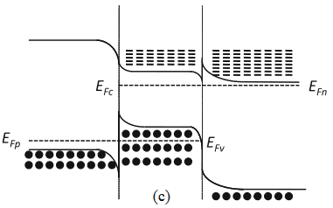
double-heterostructure laser with a lower bandgap semiconductor (GaAs) surrounded on either side by a higher bandgap semiconductor (AlGaAs)
Heterostructure Lasers
In the basic configuration of the heterostructure laser a thin layer of a suitable semiconductor material (such as GaAs) is sandwiched between two layers of a different semiconductor exhibiting a larger bandgap (such as Al_{x}Ga_{1–x}As). Thus inner layer forms two heterojunctions at the two interfaces between the semiconductors. The bandgap energy of Al_{x}Ga_{1–x}As depends on the value of x and for x<0.42, the bandgap energy can be approximated as
E_{g}=(1.424+1.266x) eV
Energy band diagram corresponding to the three regions of a double-hetero-structure laser
(a) when they are not in contact, (b) when they are in contact with no bias, (c)under forward bias.

Slide 10
At steady state, the rate at which excess carriers are being injected into the junction must equal the rate of recombination. At threshold this rate is just the spontaneous recombination rate which is given as
Where Δn is the excess carrier density, A is the area of cross section, and d is the thickness of the gain region. If J represents the current density, then the rate of injection is JA/e, where e is the electron charge. Thus we get
Typically d ∼0.1μm (for heterostructure lasers) and τ_{r}∼4 ns. Thus the threshold current density is
Note that it is due to the small value of d in heterostructure lasers that we obtain a much smaller threshold current density compared to a homojunction laser where in there is no potential step for the electrons and they diffuse away leading to a much larger value of d.

Slide 11
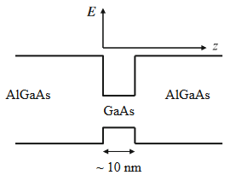
Quantum Well Laser
Schematic of energy variation of the conduction band and the valence band edge with position in separate confinement heterostructures
When light is confined into a cavity smaller than its wavelength, it behaves as a particle (quantum) rather than as a wave.
Most semiconductor lasers are very thin (20 microns or so) in the vertical direction but this is not thin enough to cause quantum behavior. In QW lasers cavity height is reduced to around 10 or 20 nm. Cavity width is generally from 5 to 10 microns.
The amount of material in the active region is substantially reduced which reduces the amount of energy needed to achieve lasing and thus the lasing threshold.
Quantum well lasers have a much reduced sensitivity to
temperature change (compared to DBR and DFB structures).
The quantum well structure produces only one line which has a narrower linewidth than for non-QW structures. The wavelength of the light emitted by a quantum well laser is determined by the width of the active region rather than just the bandgap of the material from which it is constructed.

Slide 12
Quantum Well Laser
Lasers with a single active region are called “Single Quantum Well” (SQW) lasers and number of quantum wells are used one on top of another to build “Multiple Quantum Well” structures. The separating layers between the cavities are very thin (10 to 20 nm). MQW structures produce higher gain and greater total power.
Similar to the case of an electron confinement in potential well. When L is comparable to wavelength, energy levels present in the CB and VB quantized and given by n²h²/8m_{c}L² inside CB and n²h²/8m_{v}L² in VB.
So effective bandgap responsible for emission wavelength is
Where (E_{g})_{eff} =hc/λ.
If the width of the quantum well is 10 nm and that of the heterostructure is about 100 nm, the current density required for a given gain should be about 10 times smaller in the case of quantum well laser.

Slide 13
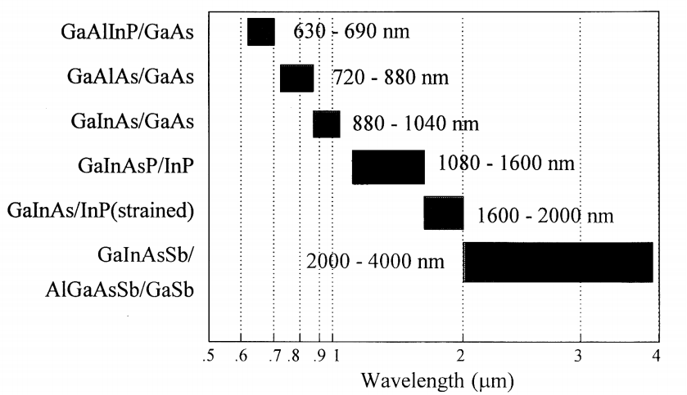
Semiconductor Laser Materials

